Slide 1
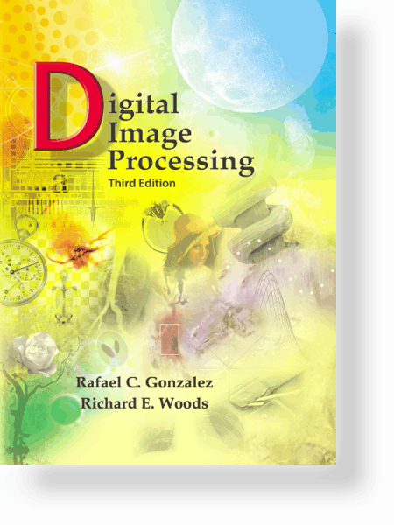
UNIT – V: Image Compression
Syllabus
Need for Image Compression
Classification of Redundancy in Images
Image Compression Models
Classification of Image Compression Schemes
Various Image Coding Techniques
Image Compression Standards
Classification of Quantization

Slide 2
UNIT – V: Image Compression
Need for Image Compression
Data storage
Data transmission
10/26/2023

Slide 3
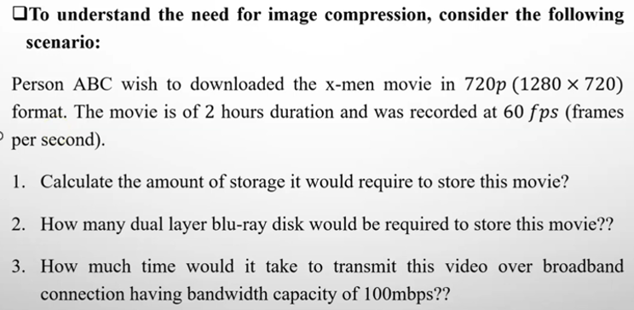
UNIT – V: Image Compression
Need for Image Compression
10/26/2023

Slide 4
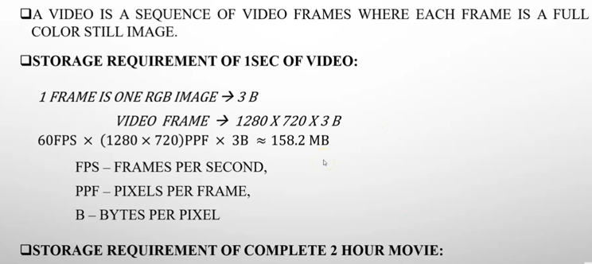
UNIT – V: Image Compression
Need for Image Compression
10/26/2023

Slide 5
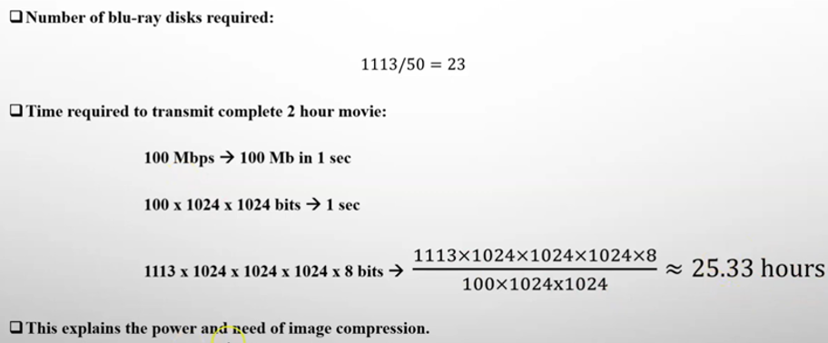
UNIT – V: Image Compression
Need for Image Compression
10/26/2023

Slide 6
UNIT – V: Image Compression
Image Compression
“ The process by which the image data storage is minimized by reducing the data redundancy can be referred as Image Compression.”
DATA = INFORMATION + REDUNDANT DATA
REDUNDANTDATA
REDUNDANTDATA
INFORMATION

Slide 7
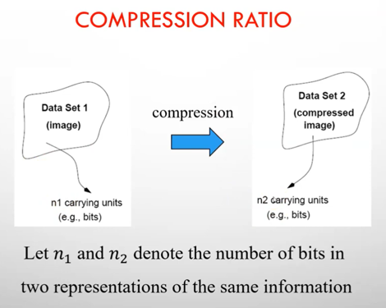

UNIT – V: Image Compression
10/26/2023

Slide 8
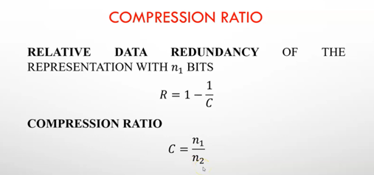
UNIT – V: Image Compression
10/26/2023

Slide 9
UNIT – V: Image Compression
Relative Data Redundancy
Let n₁ and n₂ denote the number of bits in two representations of the same information, the relative data redundancy R_{D} is
R_{D} = 1-1/C_{R (-∞, 1)}
C_{R} is called the compression ratio, defined as
C_{R} = n₁/ n_{2 (0, ∞)}
Case I: If n₂ = n_{1,} C_{R} = 1 and R_{D} = 0 no redundant data
Case II: If n₂ << n_{1,} C_{R} ∞ and R_{D} 1 highly redundant data
Case III: If n₂ >> n_{1,} C_{R} 0 and R_{D} -∞ contains more data than original
10/26/2023

Slide 10
UNIT – V: Image Compression
Classification of Redundancy in Images
Statistical redundancy
Psycho visual redundancy
Interpixel redundancy
Coding redundancy
Spatial redundancy
Temporal redundancy
10/26/2023

Slide 11
UNIT – V: Image Compression
Contd…
Spatial and Temporal redundancy
Neighboring pixels in an image are correlated spatially and video
sequences are temporally correlated
Coding redundancy
Most 2-D intensity arrays contain more bits than are needed to represent the intensities
Psycho visual redundancy
Most 2-D intensity arrays contain information that is ignored by the
human visual system
10/26/2023

Slide 12


UNIT – V: Image Compression
Coding Redundancy

Slide 13
UNIT – V: Image Compression
Contd…

Slide 14


UNIT – V: Image Compression
Spatial and Temporal Redundancy

Slide 15
UNIT – V: Image Compression
Contd…
All 256 intensities are equally probable
The intensity of each line is selected randomly, its pixels are independent of one another in the vertical direction
The pixels along each line are identical, they are maximally correlated

Slide 16
UNIT – V: Image Compression
Contd…

Slide 17

UNIT – V: Image Compression
Psycho visual Redundancy

Slide 18
UNIT – V: Image Compression
Fidelity Criteria
Objective
Subjective

Slide 19
UNIT – V: Image Compression
Contd…

Slide 20
UNIT – V: Image Compression
Contd…
RMSE = 5.17
RMSE = 15.67
RMSE = 14.17

Slide 21
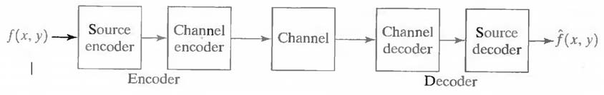
UNIT – V: Image Compression
Image Compression Models
10/26/2023

Slide 22
Mapper
Quantizer
Symbol coder
f(x,y)
Encoder
Inverse Mapper
Symbol decoder
f^(x,y)
Decoder
Block diagram of general image compression system
Mapper eliminates inter-pixel redundancy.
Quantizer eliminates psycho visual redundancy.
Symbol coder eliminates coding redundancy.

Slide 23
UNIT – V: Image Compression
Classification of Image Compression Schemes
Loss-less Compression (or) Reversible Compression
There is no information loss, and the image can be reconstructed exactly the same as the original
Applications: Medical imagery
Lossy Compression (or) Irreversible Compression
Information loss is tolerable
Many-to-1 mapping in compression eg. Quantization
Applications: commercial distribution (DVD)
10/26/2023

Slide 24
UNIT – VII: Image Compression
Various Image Coding Techniques
Run length Coding
Bit-plane Coding
Huffman Coding
Arithmetic Coding
LZW Coding
Block Truncation Coding
Block Transform Coding
Predictive Coding
Shannon-Fano coding
10/26/2023

Slide 25
UNIT – VII: Image Compression
Run length Coding
Run-length Encoding, or RLE is a technique used to reduce the size of a repeating string of characters.
This repeating string is called a run, typically RLE encodes a run of symbols into two bytes , a count and a symbol.
RLE can compress any type of data
RLE cannot achieve high compression ratios compared to other compression methods
It is easy to implement and is quick to execute.
Run-length encoding is supported by most bitmap file formats such as TIFF, BMP and PCX
10/26/2023

Slide 26
UNIT – VII: Image Compression
Example: Run length Coding
WWWWWWWWWWWWBWWWWWWWWWWWWBBBWWWWWWWWWWWWWWWWWWWWWWWWBWWWWWWWWWWWWWW
RLE coding:
12W1B12W3B24W1B14W
10/26/2023

Slide 27
UNIT – VII: Image Compression
Bit-plane Coding
An m-bit gray scale image can be converted into m binary images by bit-plane slicing. These individual images are then encoded using run-length coding.
Let I be an image where every pixel value is n-bit long
Express every pixel in binary using n bits
Form n binary matrices (called bitplanes), where the i-th matrix consists of the i-th bits of the pixels of I.
10/26/2023

Slide 28
UNIT – VII: Image Compression
Example: Bit-plane Coding
Example: Let I be the following 2x2 image where the pixels are 3 bits long
101 110
111 011
The corresponding 3 biplanes are:
1 1 0 1 1 0
1 0 1 1 1 1
RLE coding:
3110 1031 111021
10/26/2023

Slide 29
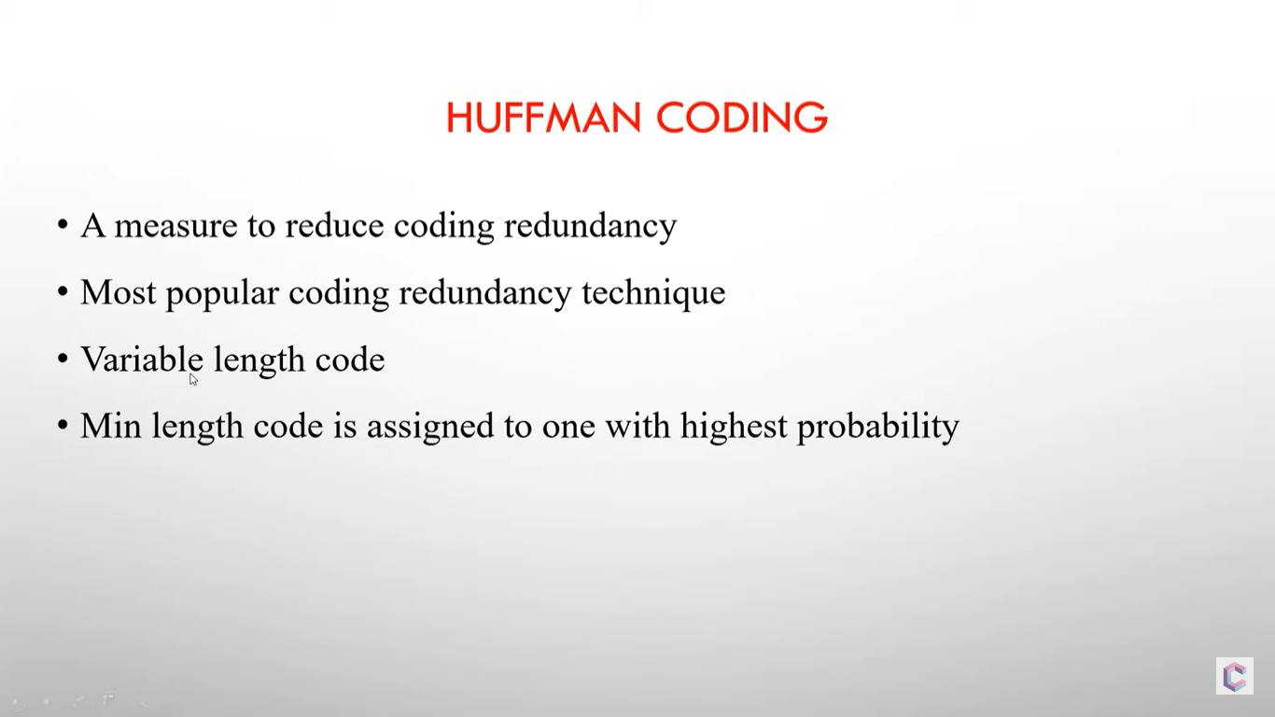
UNIT – VII: Image Compression
10/26/2023

Slide 30
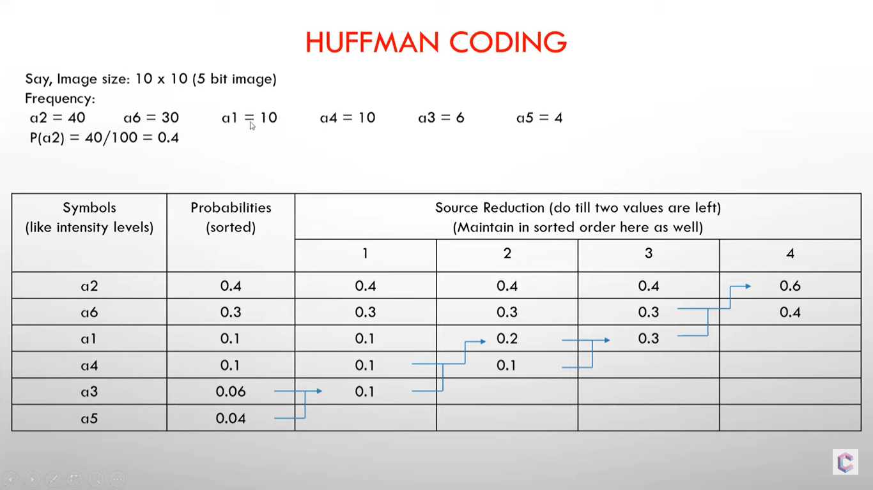
UNIT – VII: Image Compression
10/26/2023

Slide 31
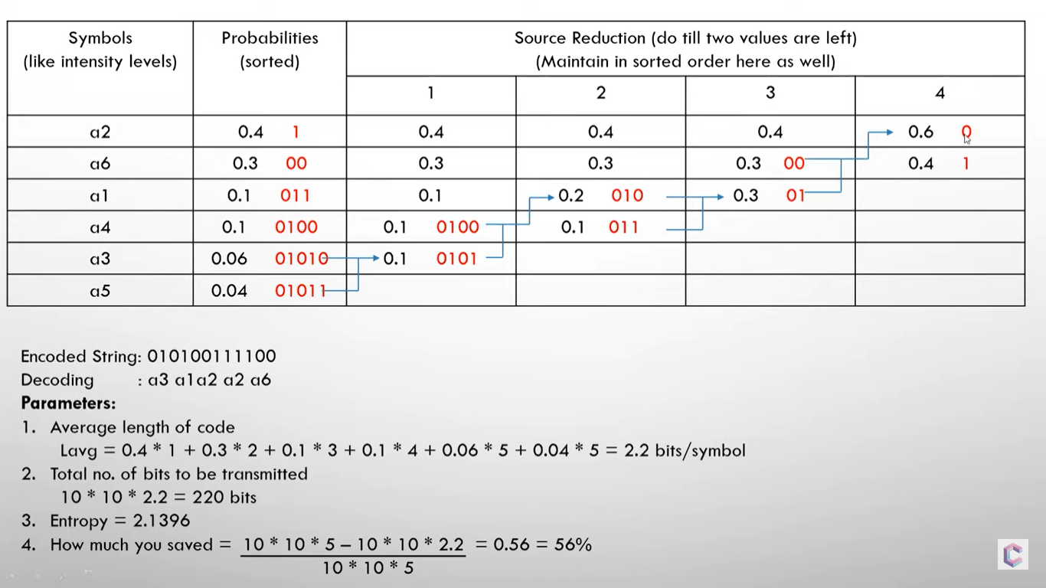
UNIT – VII: Image Compression
10/26/2023

Slide 32
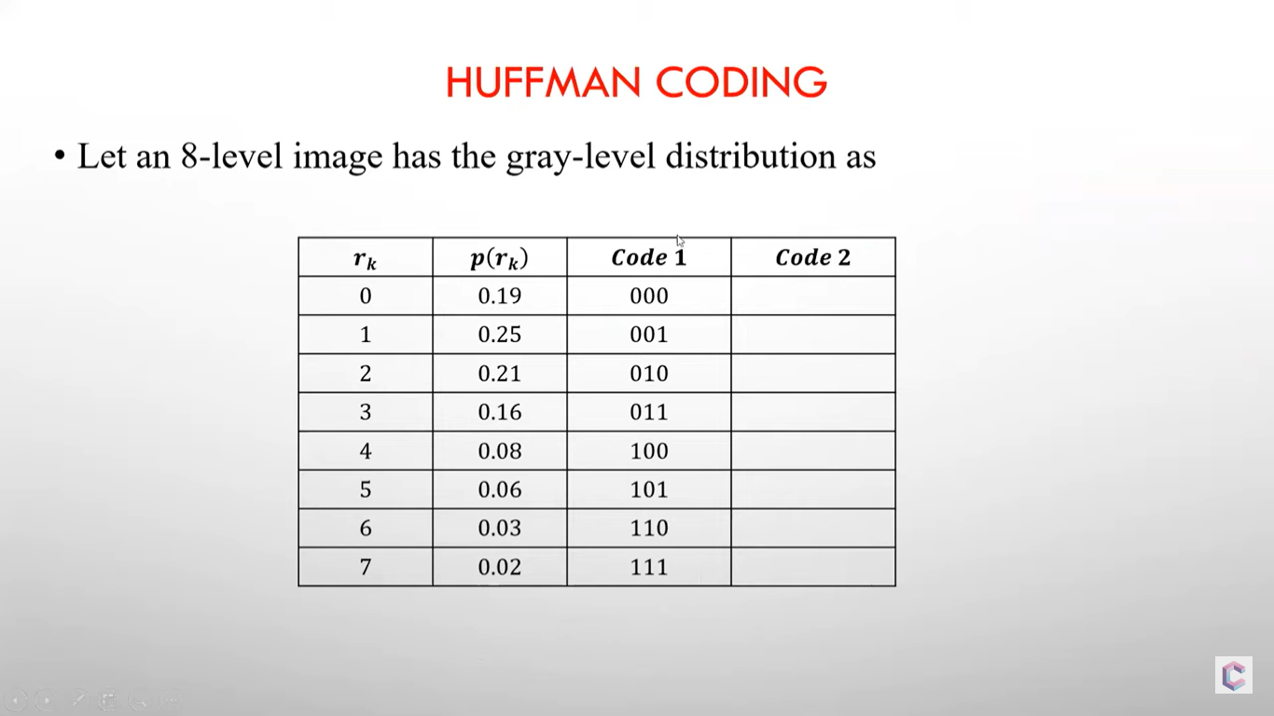
UNIT – VII: Image Compression
10/26/2023

Slide 33
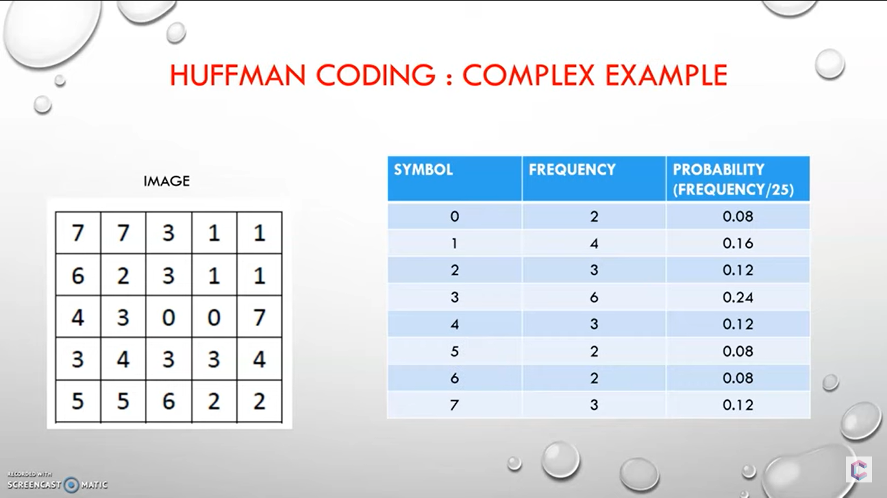
UNIT – VII: Image Compression
10/26/2023

Slide 34
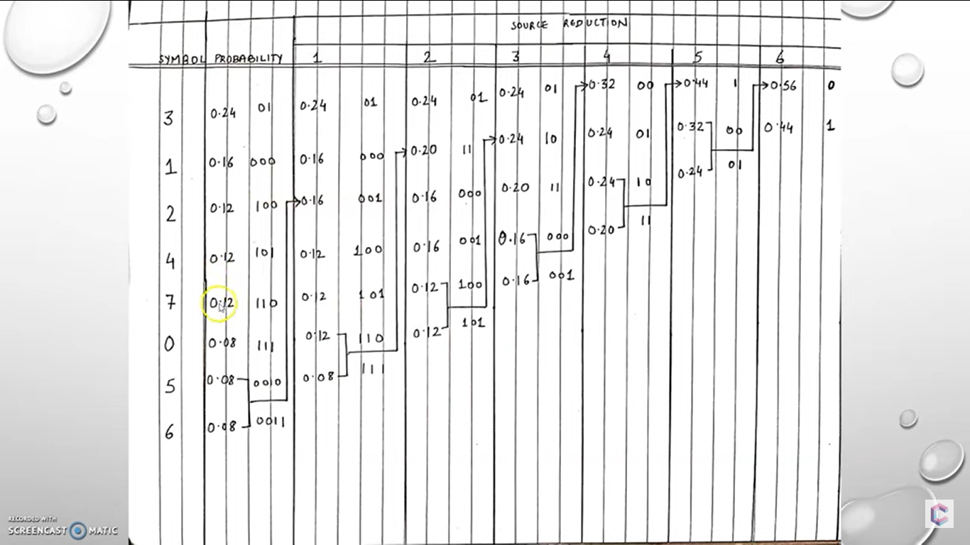
UNIT – VII: Image Compression
10/26/2023

Slide 35

UNIT – VII: Image Compression
Arithmetic Coding
How to encode a₂a₁a₂a₄?
10/26/2023

Slide 36

UNIT – VII: Image Compression
Contd…
10/26/2023

Slide 37
Decode 0.572. The length of the message is 5.
Since 0.8>code word > 0.4, the first symbol should be a₃.
1.0
0.8
0.72
0.592
0.5728
0.8
0.72
0.688
0.5856
0.57152
Therefore, the
message is
a₃a₃a₁a₂a₄
0.4
0.56
0.624
0.5728
056896
0.2
0.48
0.592
0.5664
0.56768
0.0
0.4
0.56
0.56
0.5664

Slide 38
UNIT – VII: Image Compression
LZW (Dictionary coding)
LZW (Lempel-Ziv-Welch) coding, assigns fixed-length code words to variable length sequences of source symbols, but requires not a priori knowledge of the probability of the source symbols.
- LZW is used in:
Tagged Image file format (TIFF)
Graphic interchange format (GIF)
Portable document format (PDF)
- LZW was formulated in 1984
10/26/2023

Slide 39
UNIT – VII: Image Compression
Contd…
The Algorithm
A codebook or “dictionary” containing the source symbols is constructed.
For 8-bit monochrome images, the first 256 words of the dictionary are assigned to the gray levels 0-255
Remaining part of the dictionary is filled with sequences of the gray levels
10/26/2023

Slide 40
UNIT – VII: Image Compression
Example: LZW Coding
Example:
39 39 126 126
39 39 126 126
39 39 126 126
39 39 126 126
10/26/2023

Slide 41
UNIT – VII: Image Compression
Contd…
10/26/2023

Slide 42
UNIT – VII: Image Compression
Contd…
39 39 126 126
39 39 126 126
39 39 126 126
39 39 126 126
10/26/2023

Slide 43
UNIT – IV: Image Enhancement in the Frequency Domain
Decoding LZW
Let the bit stream received be:
39 126 126 256 258 260 259 257 126
In LZW, the dictionary which was used for encoding need not be sent with the image. A separate dictionary is built by the decoder, on the “fly”, as it reads the received code words.
10/26/2023

Slide 44
UNIT – VII: Image Compression
Contd…
Recognized | Encoded value | pixels | Dic. address | Dic. entry
 | 39 | 39
39 | 39 | 39 | 256 | 39-39
39 | 126 | 126 | 257 | 39-126
126 | 126 | 126 | 258 | 126-126
126 | 256 | 39-39 | 259 | 126-39
256 | 258 | 126-126 | 260 | 39-39-126
258 | 260 | 39-39-126 | 261 | 126-126-39
260 | 259 | 126-39 | 262 | 39-39-126-126
259 | 257 | 39-126 | 263 | 126-39-39
257 | 126 | 126 | 264 | 39-126-126

Slide 45
UNIT – VII: Image Compression
Block Truncation Coding
10/26/2023

Slide 46
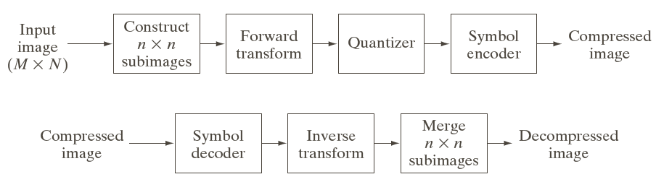
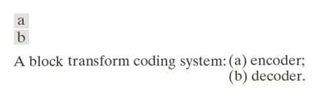
UNIT – VII: Image Compression
Block Transform Coding
10/26/2023

Slide 47
UNIT – VII: Image Compression
Predictive Coding
Example:
AAABBCDDDD encoded as A0001123333
Lossless Predictive Coding
Lossy Predictive Coding
10/26/2023

Slide 48

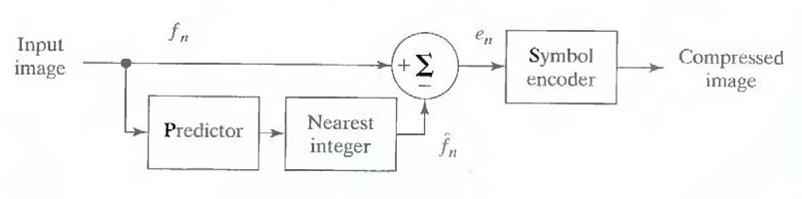


UNIT – VII: Image Compression
Lossless Predictive Encoder
10/26/2023

Slide 49

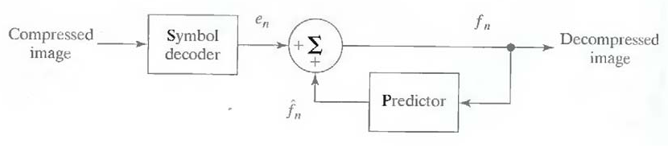
UNIT – VII: Image Compression
Lossless Predictive Decoder
10/26/2023

Slide 50
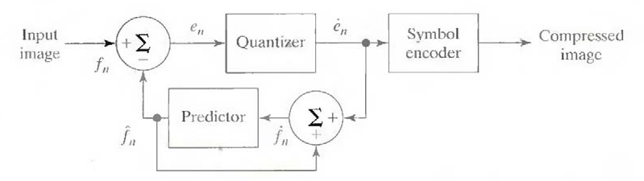


UNIT – VII: Image Compression
Lossy Predictive Encoder
10/26/2023

Slide 51
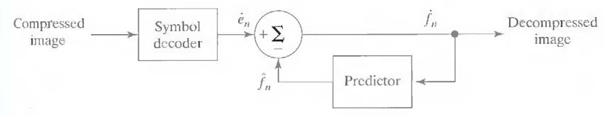
UNIT – VII: Image Compression
Lossy Predictive Decoder
10/26/2023

Slide 52
UNIT – VII: Image Compression
Image Compression Standards
JPEG
JPEG2000
10/26/2023

Slide 53
UNIT – VII: Image Compression
Quantization
Scalar Quantization
Mid-tread
Mid-rise
Vector Quantization
10/26/2023

